Slide 1
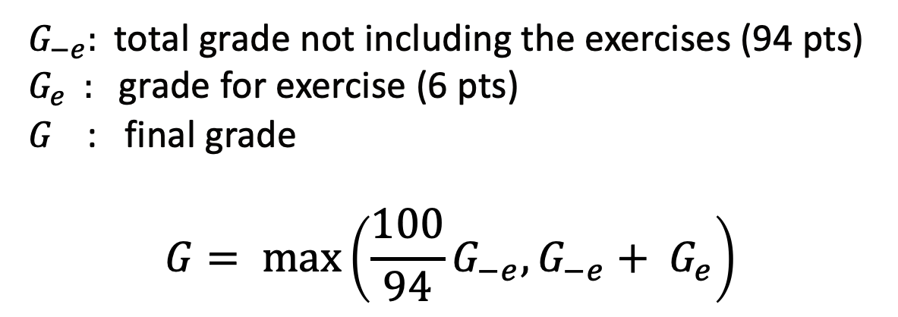
No pre-class Quizzes!
Instead we have Reading Checks which will not count towards your grade.
Post Quizzes
No changes, still drop 25%.
Exercises will count towards your grade only if it will improve your overall grade. Yes you can drop 25% of them.
${ G}_{−e}$: total grade not including the exercises (94 pts) $G_{e}$ : grade for exercise (6 pts)
$G$ : final grade
$$G= \max\left(\frac{100}{94}G_{−e}, G_{−e}+ G_{e}\right)$$

Slide 2

HW
okay to share exercise code, NOT OKAY to share hw code
okay for TFs to help w/ exercise code
HW1 is due today
HW2, 109 and 209 flavors, will be released today.
Submissions in ‘Pairs

Slide 3


